Slide 1

Blinkit Sales Analytics & Optimization Project
Data-Driven Strategies to Increase Sales at Blinkit
By Srestha Chakraborty
Notes:
Blinkit Sales Analytics & Optimization Project

Slide 2
PROJECT OVERVIEW
Content:
Project Objective
Dataset Overview
SQL Queries & Analysis
Key Insights & Visualizations
Recommendation

Slide 3
PROJECT OBJECTIVE
Leverage data-driven insights from Blinkit’s sales and customer behavior to identify key growth opportunities, improve decision-making, and drive a measurable increase in overall sales by using MYSQL.

Slide 4
DATASET OVERVIEW
Key Tables :
- Orders (Order details – order id, customer id, delivery time)
- Order_items (order line items – product_id, quantity, unit price)
- Products (Product information –product name, category)
Time range – 2023 - 2024
Primary Metrics –
Customer Spend Analysis
Category performances
Product-Level Sales
Monthly Sales Trends
Time-Based Sales Analysis.

Slide 5
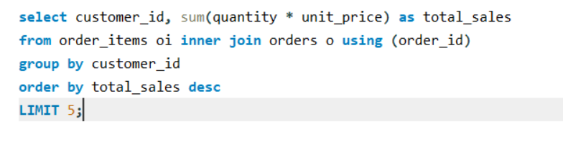
WHICH CUSTOMERS CONTRIBUTE MOST TO OUR TOTAL SALES?
INSIGHTS:
Prioritizing these customers with loyalty rewards, personalized offers, and retention strategies can maximize long-term revenue.
Targeting this group also reduces churn and improves customer lifetime value.

Slide 6
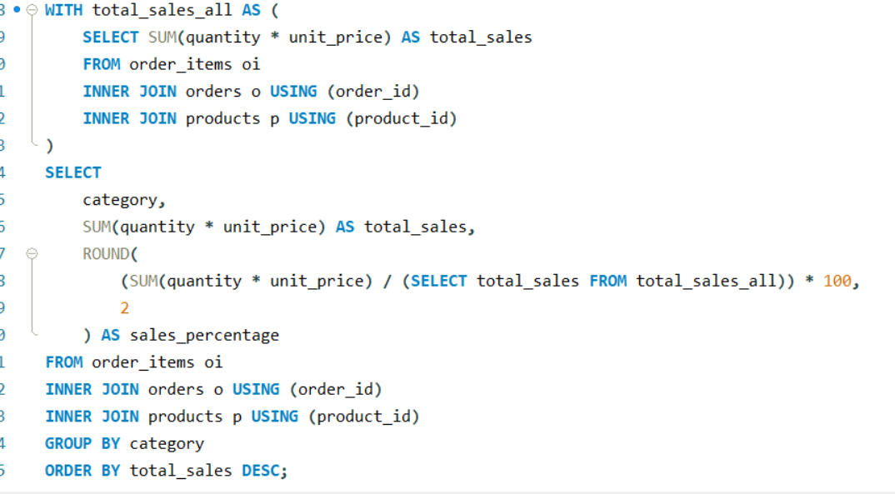
WHICH PRODUCT CATEGORIES CONTRIBUTE MOST TO OUR TOTAL SALES ?
INSIGHTS:
Category-wise performance indicates where customers spend most, guiding targeted marketing.
Identifies high-demand categories that drive business growth.

Slide 7
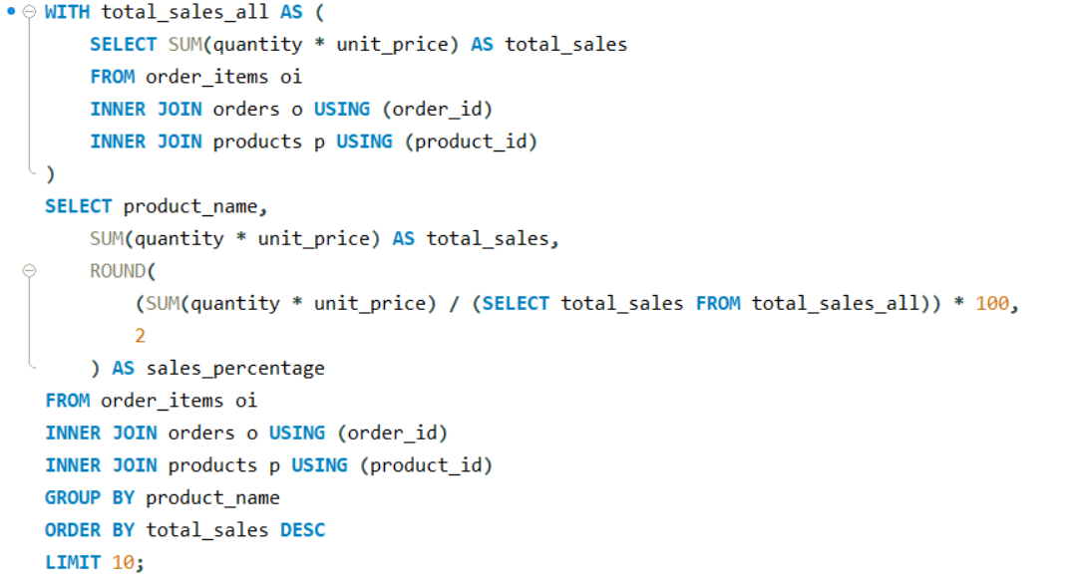
WHICH PRODUCTS CONTRIBUTE MOST TO THE COMPANY’S SALES REVENUE?
INSIGHTS:
Identifying top-selling products allows Blinkit to focus on the most profitable items.
Prioritizing these products in promotions and inventory decisions can help drive sales growth and reduce the risk of stockouts.

Slide 8
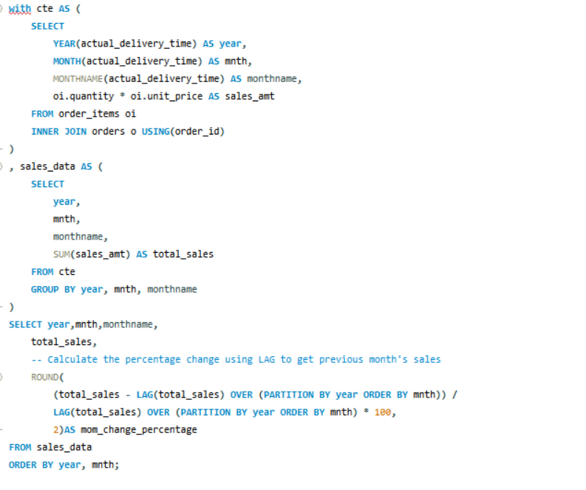
HOW DOES TOTAL SALES PERFORMANCE VARY MONTH OVER MONTH, AND ARE WE EXPERIENCING CONSISTENT GROWTH?
INSIGHTS :
The MoM growth curve reveals volatility, suggesting that Blinkit’s performance is seasonally impacted and not consistently upward.
Monitoring MoM performance helps identify underperforming periods and refine marketing, inventory, and promotional strategies.

Slide 9
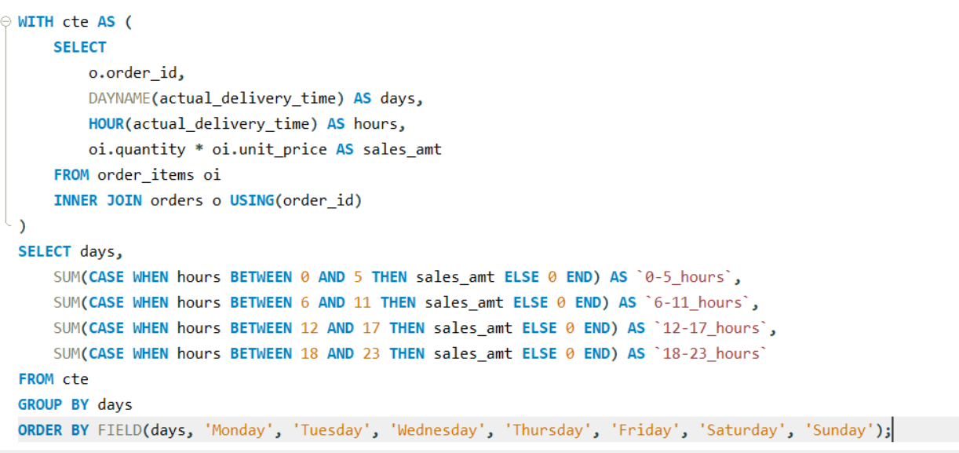
WHEN THE CUSTOMERS ARE MOST ACTIVE THROUGHOUT THE WEEK AND THROUGHOUT THE DAY?
INSIGHTS:
Time-based sales patterns highlight peak shopping periods, allowing the company to optimize staff schedules and promotional timing.
Aligning operations with customer demand ensures better service and can boost sales during high-traffic periods.
days | 0-5_hours | 6-11_hours | 12-17_hours | 18-23_hours
Monday | 174317 | 166805 | 170884 | 175338
Tuesday | 201857 | 168243 | 155669 | 217402
Wednesday | 177684 | 185939 | 205599 | 173684
Thursday | 196155 | 169182 | 184948 | 168550
Friday | 168127 | 170847 | 154109 | 185144
Saturday | 196741 | 185935 | 172531 | 151919
Sunday | 166217 | 196252 | 177260 | 155139

Slide 10
FINDINGS
Key Findings
1. High-Spending Customers
- A small group drives most revenue — ideal for targeted retention and loyalty campaigns.
2. Category-Wise Total Sales (%)
- Categories like Dairy & Breakfast, Pharmacy, Fruits & Vegetables contribute most to sales — prioritize stock and promotions for these.
3. Product-Wise Total Sales (%)
- Identified top-selling products that can be pushed via promotions and better shelf availability.
4. Month-over-Month Total Sales
- Sales performance showed high volatility month-over-month, with inconsistent growth patterns and a sharp decline in November 2024 requiring investigation.
5. Day vs. Hour Total Sales
- Peak sales times and days highlight when to increase advertising and optimize staff shifts.

Slide 11
RECOMMENDATIONS
1. High Spend Customer Analysis
- Implement targeted loyalty programs and personalized campaigns to retain and grow these high-value customers.
2. Category-Wise Total Sales (%)
- Prioritize top-performing categories for promotions, stock management, and marketing to maximize category-level sales.
3. Product-Wise Total Sales (%)
- Focus on top-selling products with tailored promotions, discounts, and ensuring consistent availability to boost repeat purchases.
4. Month-over-Month Total Sales
- Implement proactive monthly sales monitoring and align marketing strategies to stabilize performance and capitalize on high-growth periods.
5. Day vs. Hour Total Sales
- Adjust marketing campaigns and allocate more delivery and staff capacity during sales periods to improve service and maximize service

